Slide 1
Expressive Tempo Controller
Project Presentation
Adrien Bélanger - 261118168

Slide 2
Idea and Motivation

Slide 3
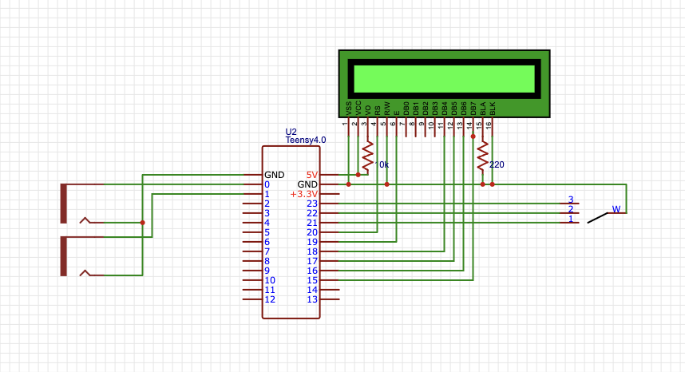
Circuitry

Slide 4
Code and Program

Slide 5
Challenges and Solution
Challenges | Solutions
Not enough digital pins on the Arduino and refresh rate too low | Switched to Teensy
Beat-by-beat control was too hard to implement in the time frame | Switched to tempo switching instead of beat-by-beat control
Soldering Issues | Debugging and resoldering

Slide 6
Demonstration

Slide 7
Future Directions

